Slide 2

Welcome

Slide 3
R … you Ready? Jedi Stats with R and Tableau
#JediStatsR
Konstantin Greger Lennart Heuckendorf
Sales Consultant Sales Consultant
Tableau Tableau

Slide 4

… Ready for This?
Part I
Introduction to R & RStudio
Introduction to R Integration
Adding a Parameter
Understanding the Table Calculation
Part II
t-Test
Finding Closest Features
Graph Analysis

Slide 5


R ... you Ready?
Star Wars or Star Trek?
And how ready R you?
bit.ly/TC17Rpoll

Slide 6
R & RStudio

Slide 7

Source: https://i.ytimg.com/vi/vc0vMeQxBsU/maxresdefault.jpg

Slide 8
Tableau R Integration

Slide 9
Parameters

Slide 10
R-ameters

Slide 11
The Table Calculation

Slide 12

Source: https://s-media-cache-ak0.pinimg.com/originals/7a/dc/f4/7adcf41aa1bfa6d25feb7b71fea7eea1.jpg

Slide 13
R ... you Ready?
Star Wars or Star Trek?
And how ready R you?
bit.ly/TC17Rpoll

Slide 14
set.seed(4681100) paste0(sample(letters, 5, TRUE), collapse = "")
Source: https://s-media-cache-ak0.pinimg.com/originals/7a/dc/f4/7adcf41aa1bfa6d25feb7b71fea7eea1.jpg

Slide 15
t-Test

Slide 16

Source: https://i.ytimg.com/vi/gHGKl_pMgTk/maxresdefault.jpg

Slide 17

Source: https://media.giphy.com/media/1eKbAKgocJCta/giphy.gif

Slide 18
Finding the Closest Features

Slide 19

Source: https://www.urlaubsguru.de/wp-content/uploads/2015/02/urlaubsguru.de_hangover-trip-las-vegas-stratosphere-hotel-casino-guenstige-fluege-671e1.jpg

Slide 20
Graph Analysis

Slide 21
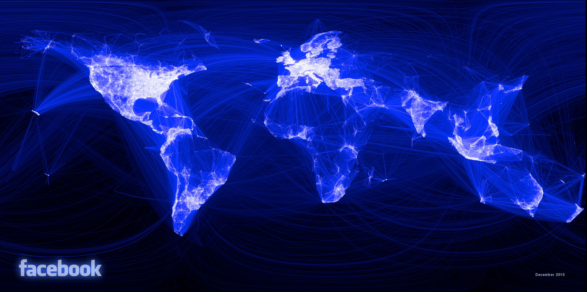
Source: http://networked360.com/wp-content/uploads/FacebookNetwork.jpg

Slide 22
What we Covered Today
Part I
Introduction to R & RStudio
Introduction to R Integration
Adding a Parameter
Understanding the Table Calculation
Part II
t-Test
Finding Closest Features
Graph Analysis

Slide 23
Konstantin Lennart Greger Heuckendorf
#JediStatsR
kgreger@tableau.com lheuckendorf@tableau.com
@kogreger @lheuckendorf

Slide 24
SESSION REPEATS
Day of Week, Month Day Session Title
Time – Time | Location
Day of Week, Month Day Session Title
Time – Time | Location
Day of Week, Month Day Session Title
Time – Time | Location

Slide 25
RELATED SESSIONS
Friday, October 23 Beginning Your Geographic Analysis Journey
11:30am – 12:30pm | Location
Friday, October 23 Beginning Your Geographic Analysis Journey
11:30am – 12:30pm | Location
Friday, October 23 Beginning Your Geographic Analysis Journey
11:30am – 12:30pm | Location

